Slide 1
EDA LOAN CASE STUDY
Chaitanya Ugale & Kapila Gaur

Slide 2

Business UNDERSTANDING
The loan providing companies find it hard to give loans to the people due to their insufficient or non-existent credit history. Because of that, some consumers use it as their advantage by becoming a defaulter.
We are working for a consumer finance company which specializes in lending various types of loans to urban customers.
We have analyzed the patterns present in the data which ensure that the applicants capable of repaying the loan are not rejected.

Slide 3
Total CURRENT APPLICATION DATA COlUmn : 122
NULL VALUES
More than 45% Null Values
67
49
Less than 15% Null Value
Unwanted Columns
16
32

Slide 4
DATA EXPLORATION : CLEANING
45%
Removed the Columns having more than 45% of Null Values as we can Impute values in place of null values.
15%
For the columns containing less than 15% of null values we have imputed as per median or income condition

Slide 5
OUTLIERS FOR CURRENT APPLICATION DATA

Slide 6
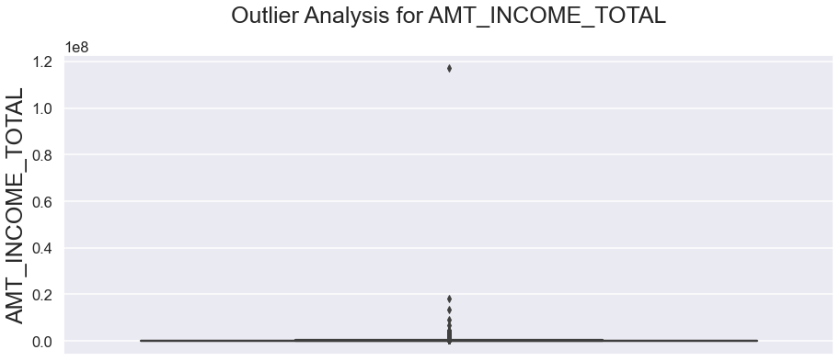
AMT_INCOME_TOTAL(Total INCOME)
Maximum Income
Outlier
1 Lakh – 3 Lakh
11 Cr

Slide 7
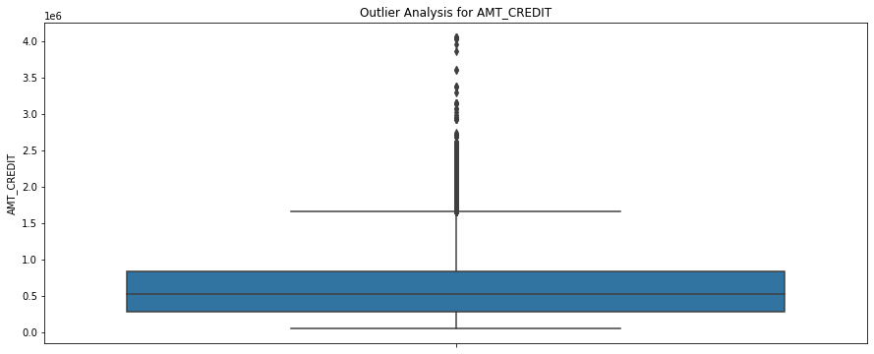
AMT_CREDIT (CREDIT)
MAX CREDIT LOAN
OUTLIERS
Median
17 Lakhs
37 Lakhs – 40 Lakhs
5 Lakhs

Slide 8
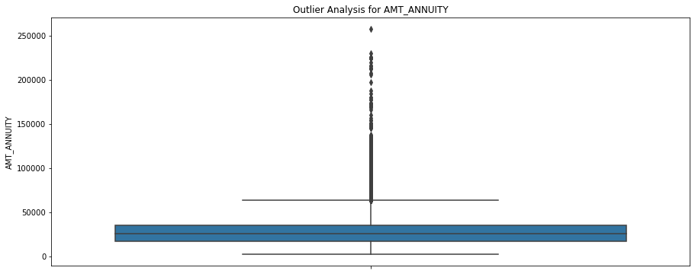
AMT_ANNUITY (CREDIT)
MAX ANNUITY
OUTLIERS
Median
60K
2.5 Lakhs
25K

Slide 9
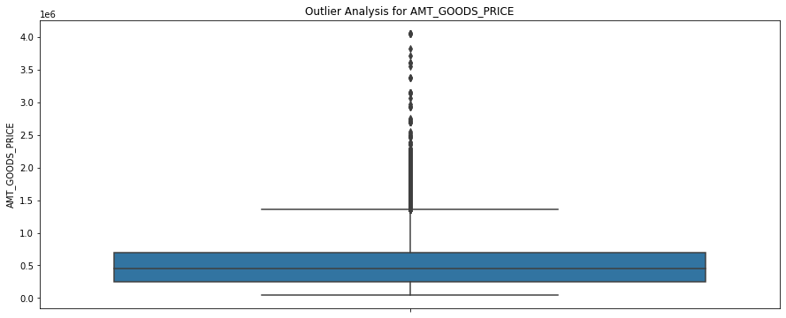
AMT_GOODS_PRICE
MAX CREDIT LOAN
OUTLIERS
Median
14 Lakhs
40 Lakhs
4.5 Lakhs

Slide 10
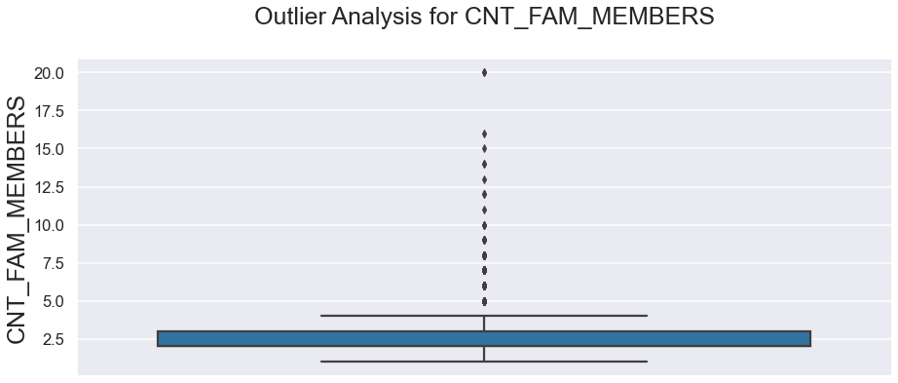
CNT_FAM_MEMBERS
MAX MEMBER
OUTLIERS
Median
4
20
2

Slide 11
DATA IMBALANCE iN TARGET

Slide 12
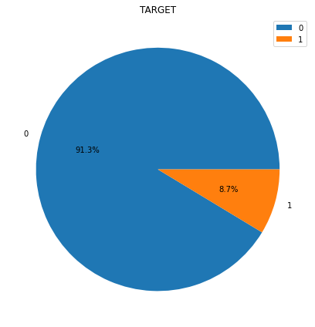
Product Benefits
8.7%
Target 1 are having payment difficulties and having a late payment
91.3%
Target 0 are not having any loan payment difficulties

Slide 13
UNIVARIAte ANALYSIS FOR TARGET 0

Slide 14
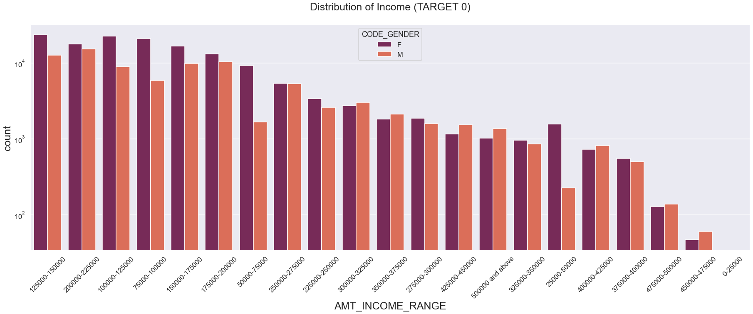


INCOME DISTRIBUTION
Female’s Highest Income Range
Male’s Highest Income Range
Highest Applicants
2.5K– 3 Lakhs
3 Lakhs and above
>

Slide 15
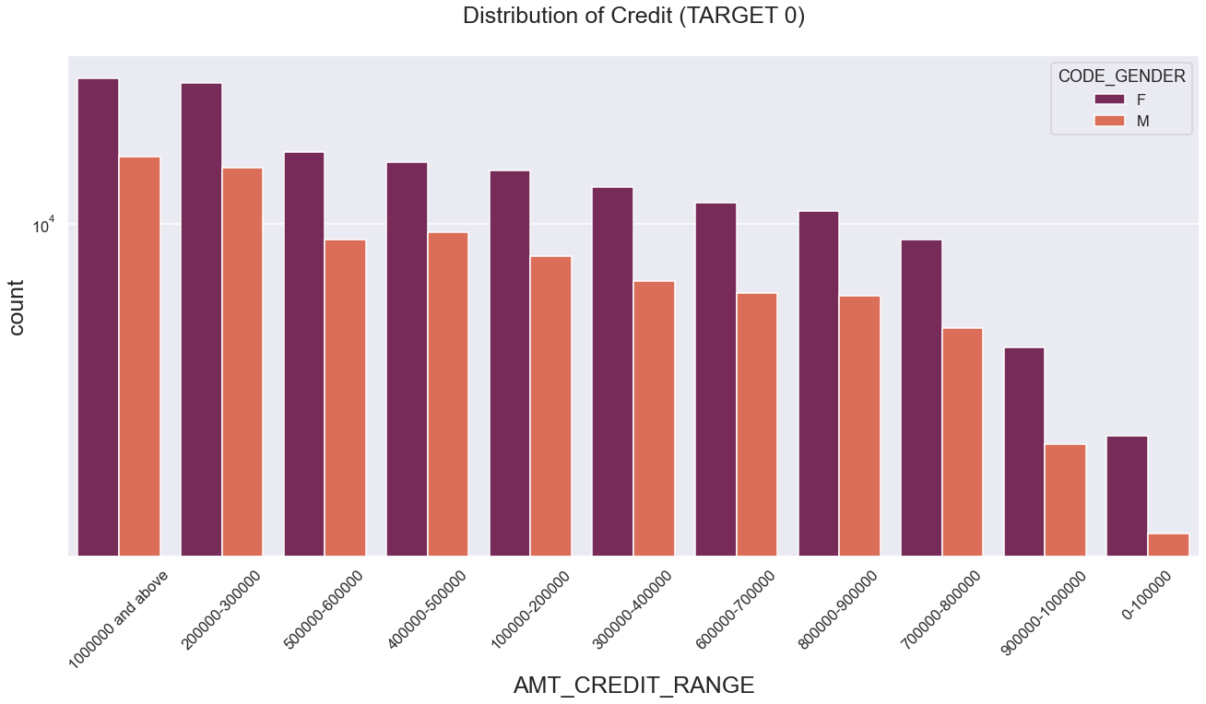
CREDIT DISTRIBUTION
Highest Applicants
Highest Applicants in Credit Range
Lowest Application in Credit Range
>
10 Lakhs and Above
0 – 1 Lakh

Slide 16
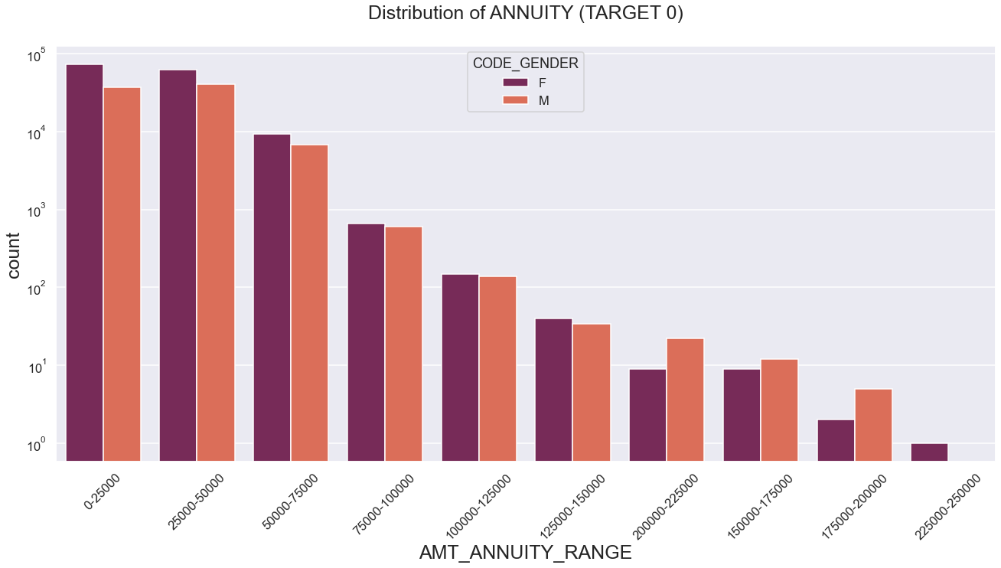
ANNUITY DISTRIBUTION
Highest Count of Annuity
Lowest Count of Annuity
Female’s Highest Annuity Range
Male’s Highest Annuity Range
0-25K
2.25 Lakh – 2.5 Lakh
0-1.5Lakh
1.5 Lakhs to 2.5 Lakh

Slide 17
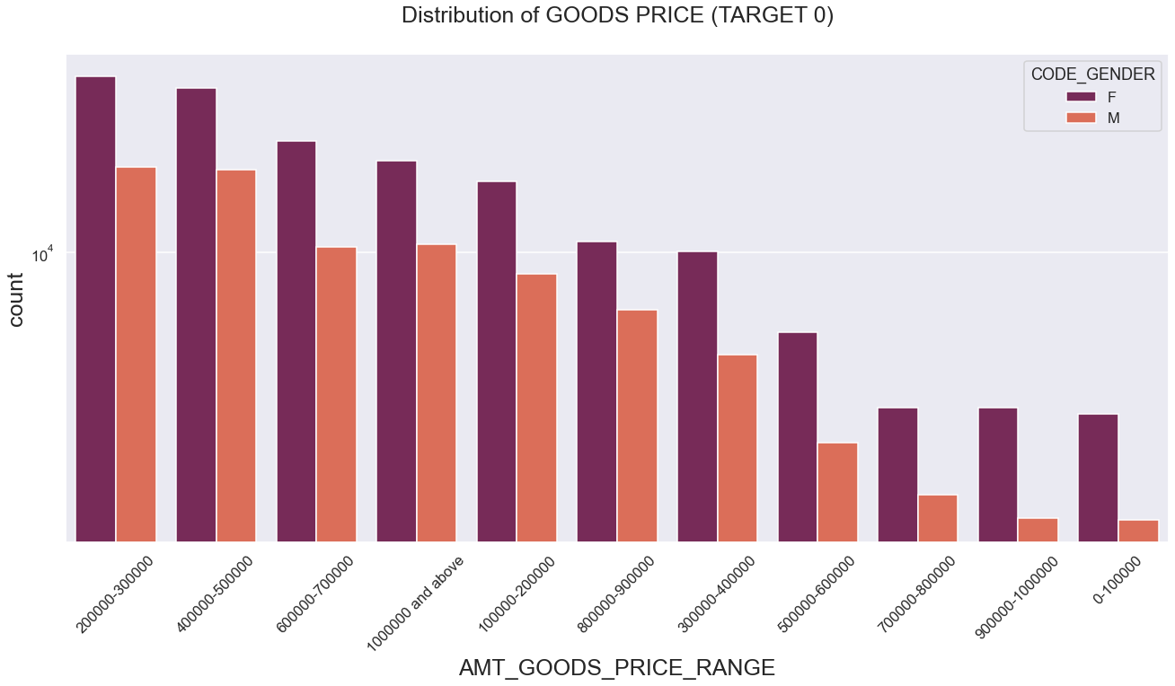
GOODS PRICE DISTRIBUTION
Highest Applicants
Highest Applicants in High Goods Price
Lowest Application in High Goods Price
>
2 Lakh – 3 Lakh
0 – 1 Lakh

Slide 18
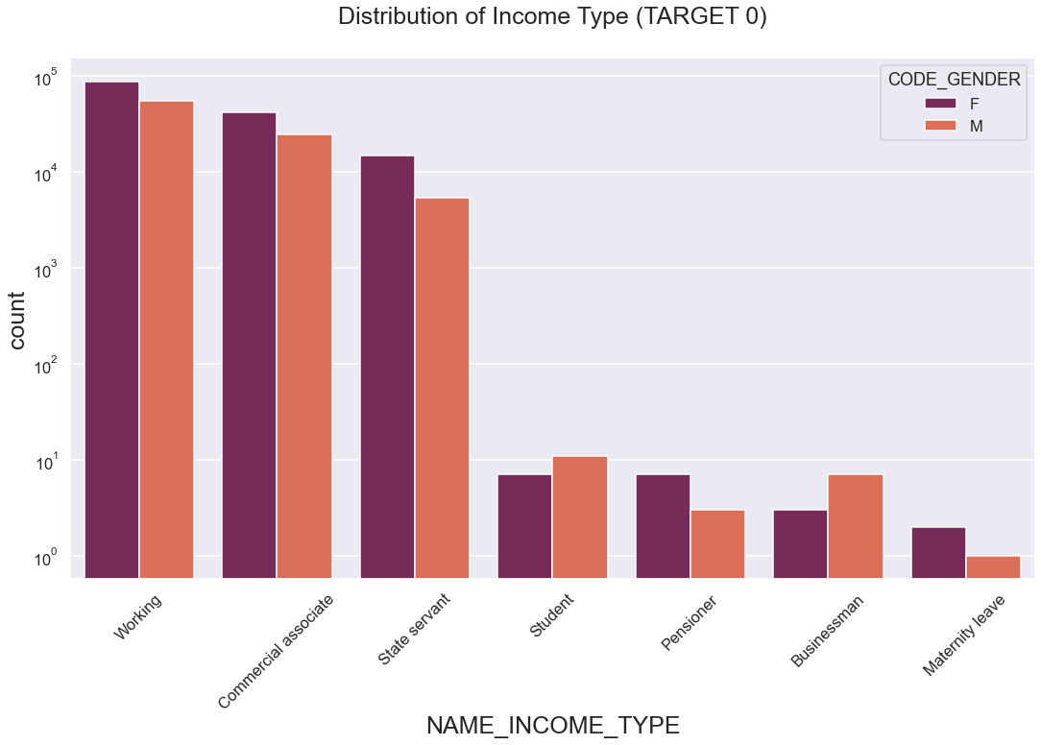
INCOME TYPE DISTRIBUTION
Working
Commercial Associate
State Servant
Pensioner
Maternity Leave
Student
Businessman

Slide 19
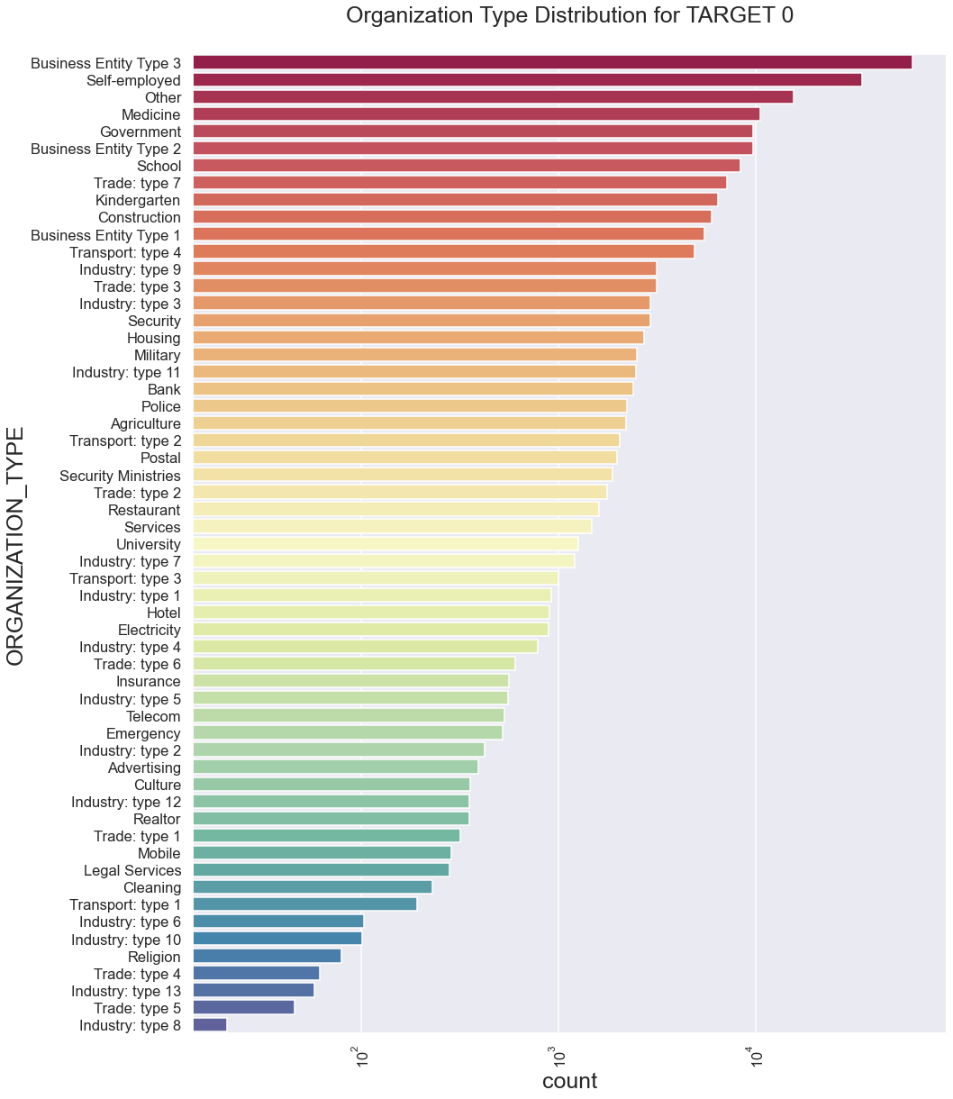


ORGANIZATIOn TYPE
26%
Business Entity Type 3 is highest organization
Business Entitlement Type 3
Self – Employed
Others
Industry Type 13
Industry Type 8
Trade Type 5

Slide 20
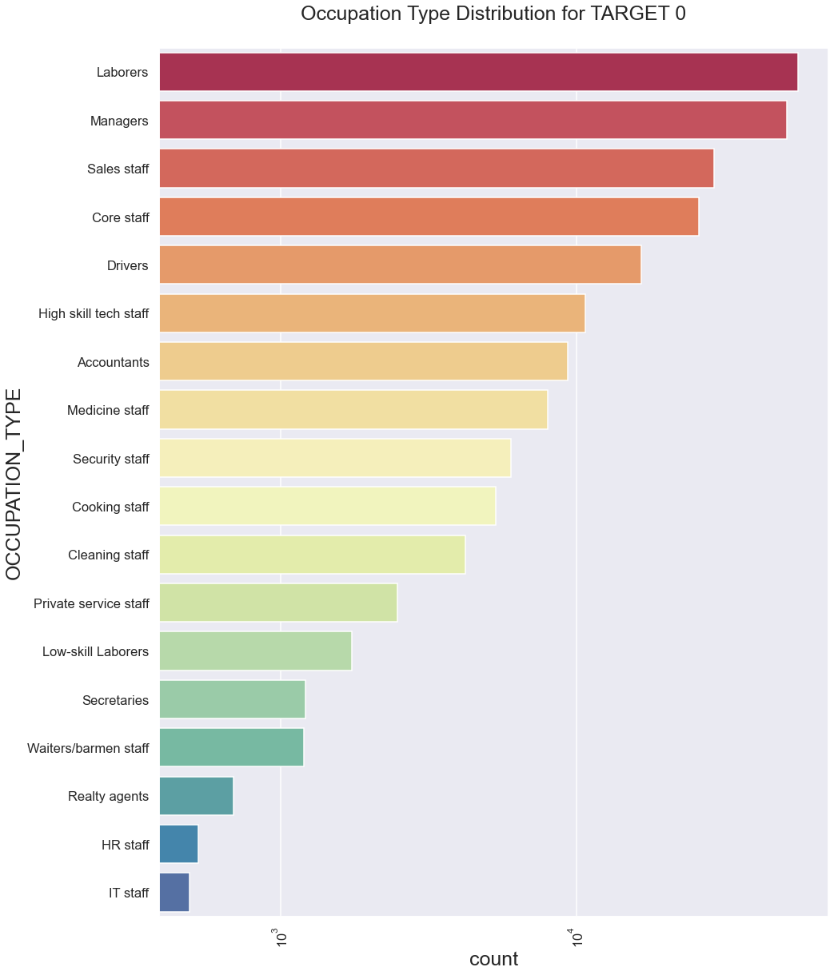
Occupation
24%
Laborers is highest Occupation
Laborers
Managers
Sales Staff
Realty Agent
HR Staff
IT Staff

Slide 21
UNIVARIAte ANALYSIS FOR TARGET 1

Slide 22
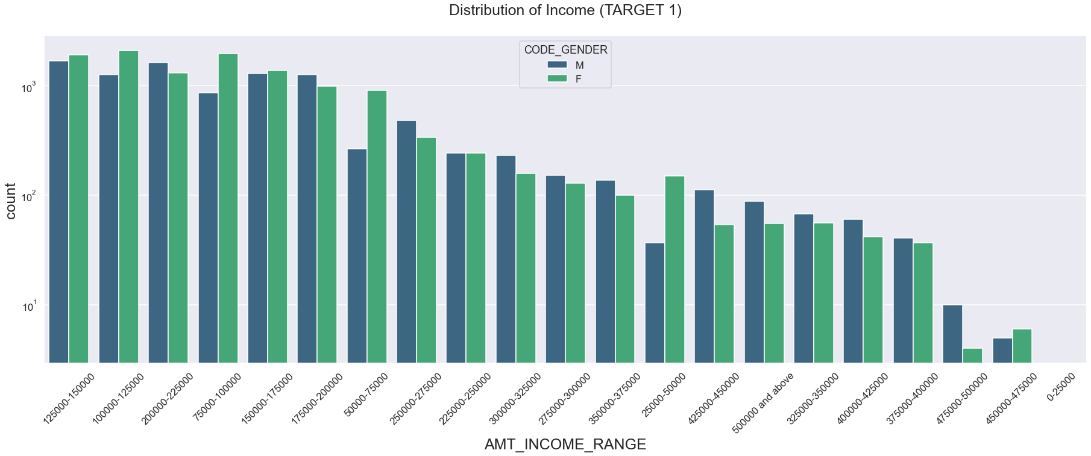
INCOME DISTRIBUTION
Female’s Highest Income Range
Male’s Highest Income Range
Highest Applicants
2.5K– 3 Lakhs
3 Lakhs and above
>

Slide 23
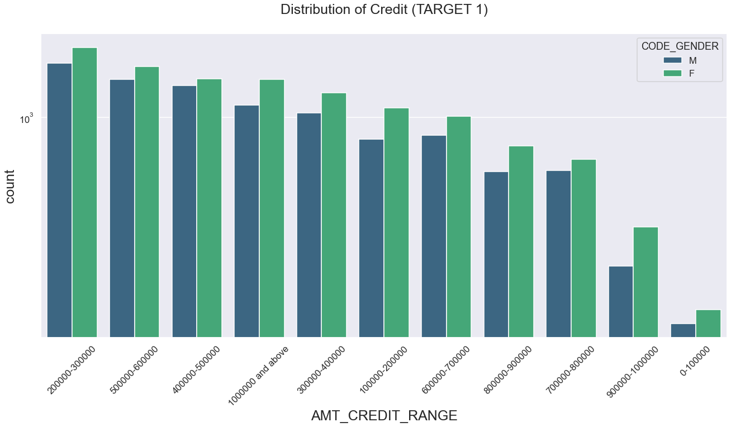
CREDIT DISTRIBUTION
Highest Applicants
Highest Applicants in Credit Range
Lowest Application in Credit Range
>
2 Lakhs – 3 Lakhs
0 – 1 Lakh

Slide 24
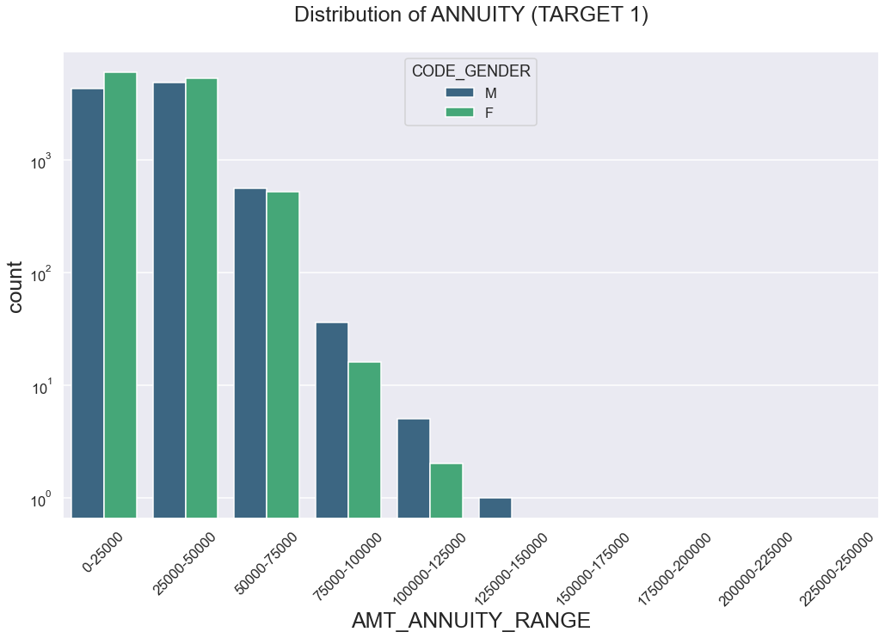
Annuity Distribution
Highest Count of Annuity
Lowest Count of Annuity
Female’s Highest Annuity Range
Male’s Highest Annuity Range
0-25K
1.25 Lakh – 1.5 Lakh
0-75K
75K -1.5 Lakh

Slide 25
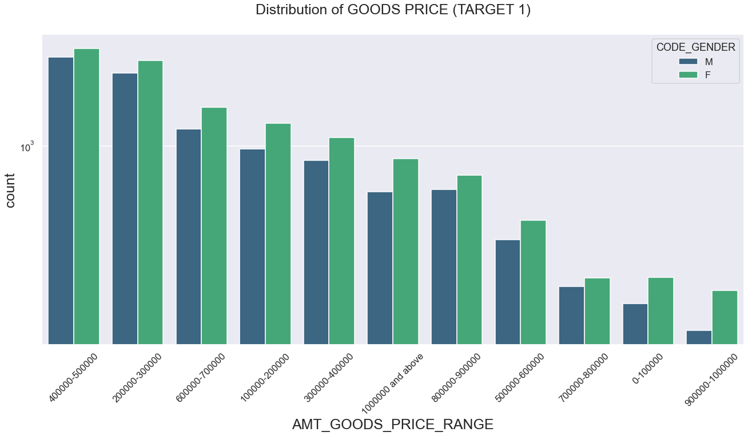
GOODS PRICE DISTRIBUTION
Highest Applicants
Highest Applicants in High Goods Price
Lowest Application in High Goods Price
>
4 Lakh – 5 Lakh
9 Lakh – 10 Lakh

Slide 26
GOODS PRICE DISTRIBUTION
Highest Applicants
Highest Applicants in High Goods Price
Lowest Application in High Goods Price
>
4 Lakh – 5 Lakh
9 Lakh – 10 Lakh

Slide 27
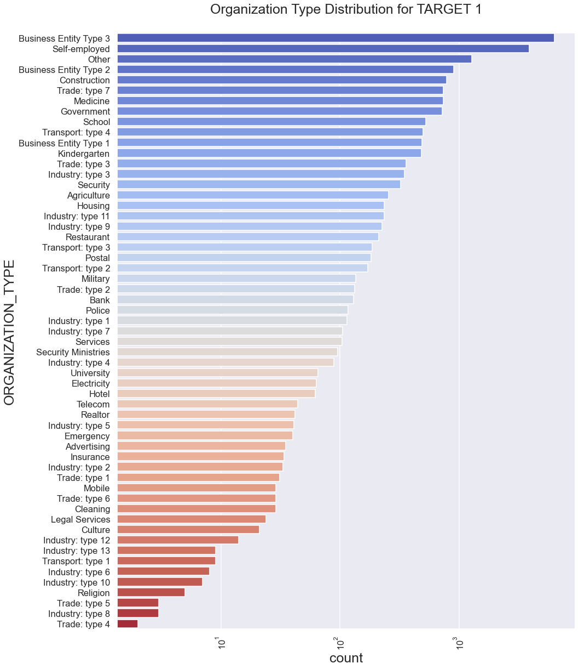
ORGANIZATIOn TYPE
28%
Business Entity Type 3 is highest organization
Business Entitlement Type 3
Self – Employed
Others
Trade Type 4
Industry Type 8
Trade Type 5

Slide 28
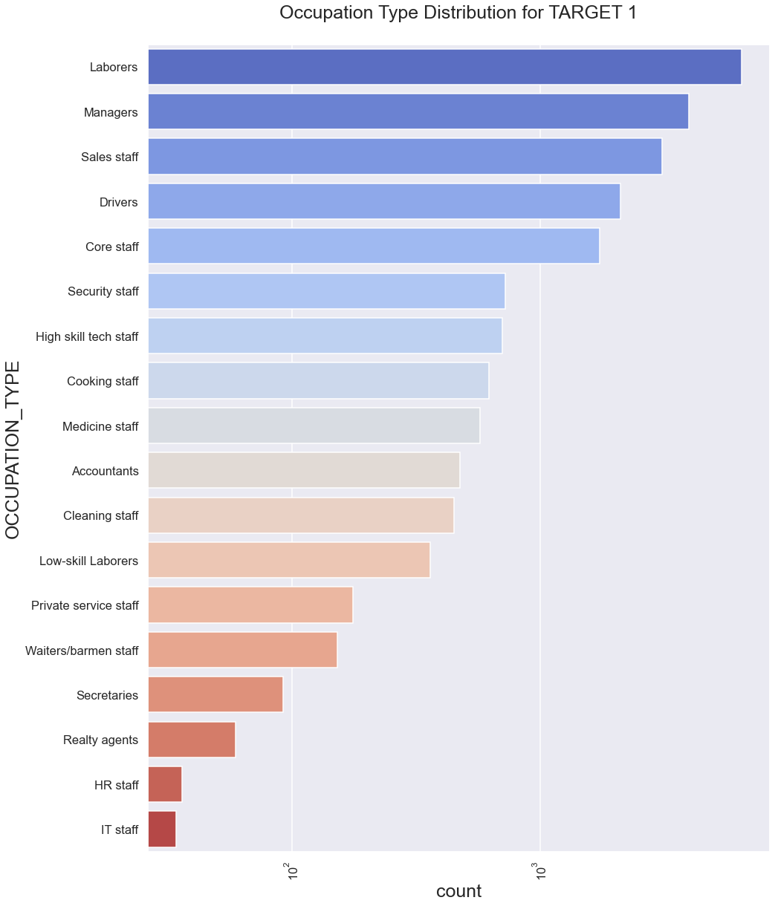
Occupation
29%
Laborers is highest Occupation
Laborers
Managers
Sales Staff
Realty Agent
HR Staff
IT Staff

Slide 29
TARGET CORRELATION

Slide 30
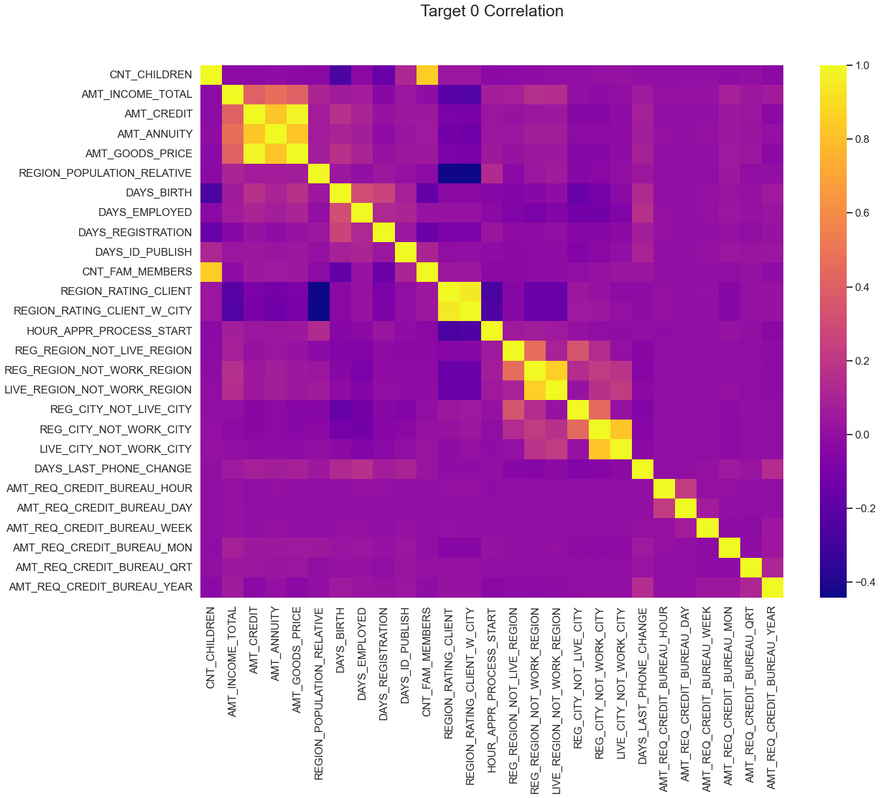
TARGET 0
Amount good price is highly correlated with Amount credit.
Region rating client has negative correlation region population relative.
Amount Annuity has positive correlation with amount credit

Slide 31
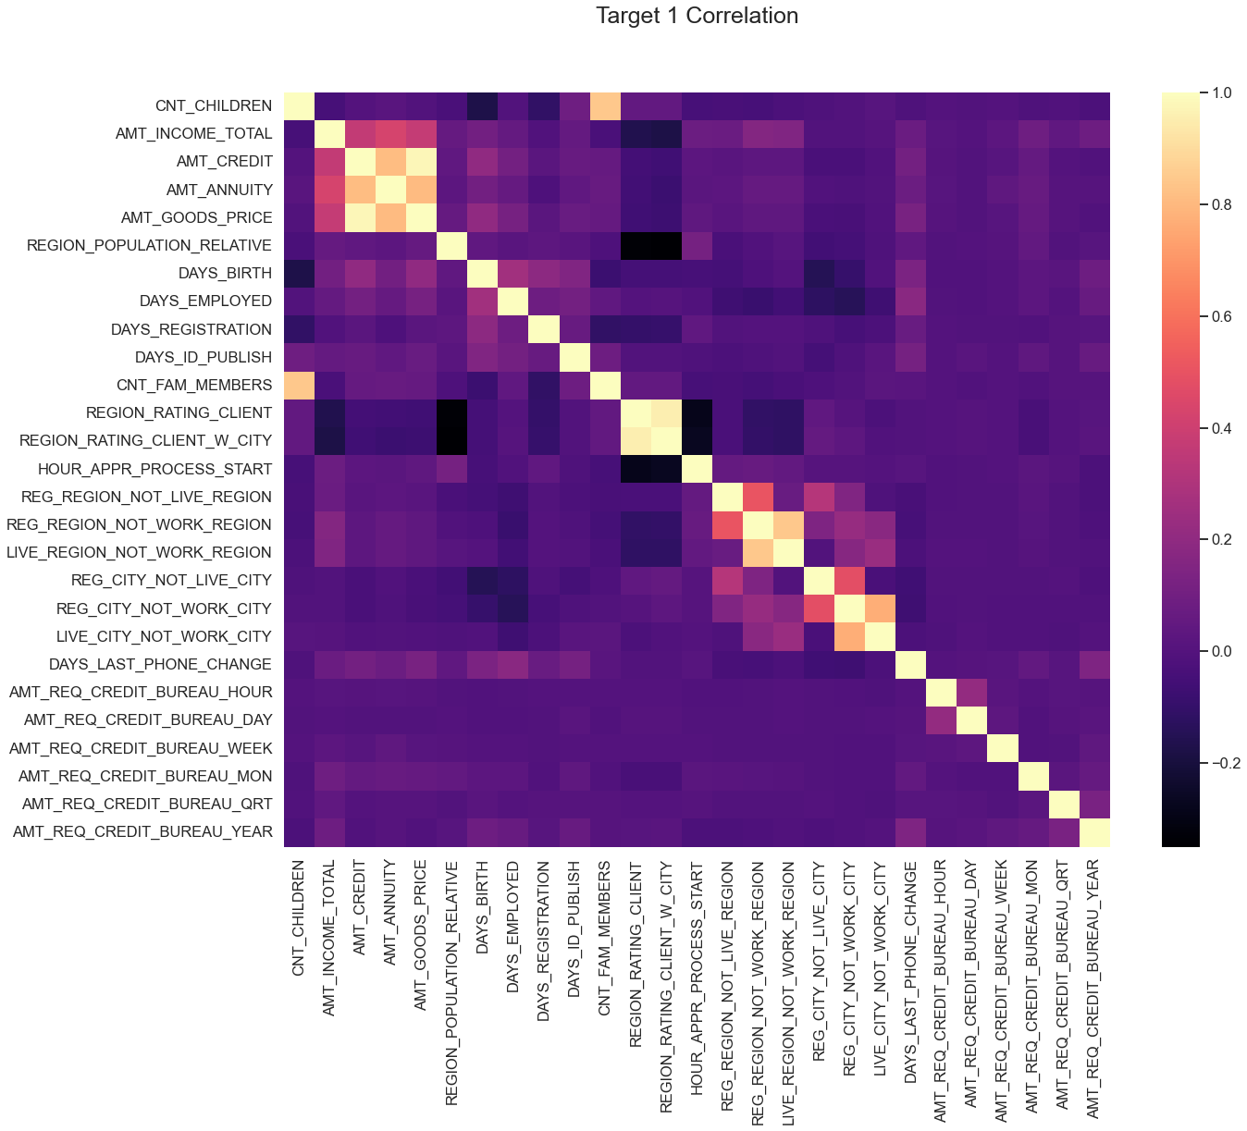
TARGET 1
1.Credit amount is highly correlated with good price amount for target -1.
Amount annuity is correlation amount credit.
There is a the correlation (~0.4) between total income of the applicant and the credit amount.
There is inverse correlation between amount income and number of employment days.
Count of family members has a high correlation with count of children.

Slide 32
BIVARIATE ANALY FOR TARGET 0

Slide 33
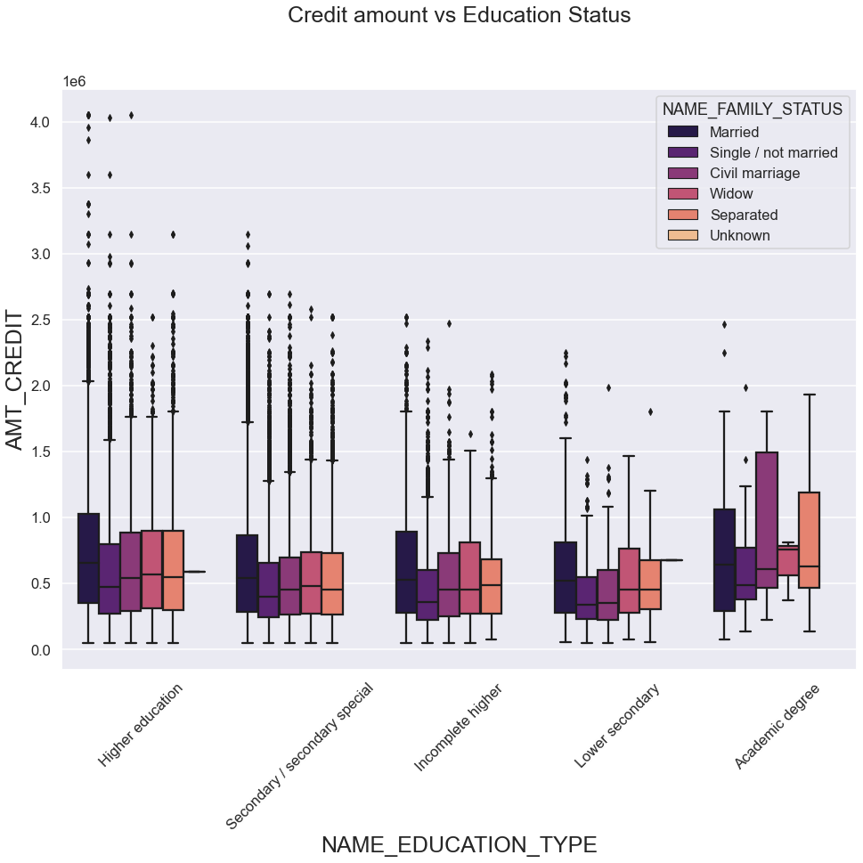
CREDIT vs EDUCATION STATUS
Highest Credit
Academic Degree with Family Status
MARRIED , CIVIL MARRIAGE and SEPERATED
Lower secondary & academic degree with family status SINGLE and NOT MARRIED
50%
Higher Education with family status MARRIED , CIVIL MARRIAGE and SINGLE
Outliers

Slide 34
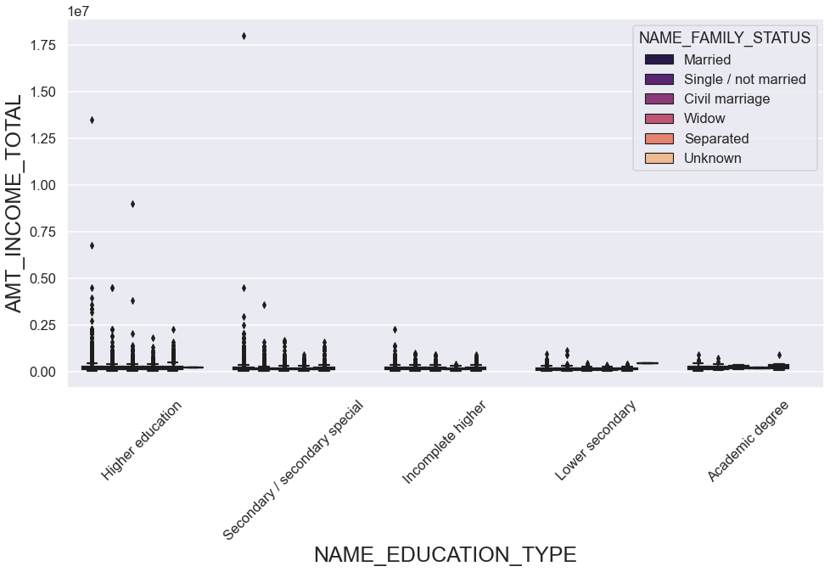
INCOME vs EDUCATION STATUS
Highest Income
Academic Degree with Family Status
MARRIED , CIVIL MARRIAGE and SEPERATED
Lower secondary & academic degree with family status SINGLE and NOT MARRIED
50%
Secondary Special with family status MARRIED
Outliers

Slide 35
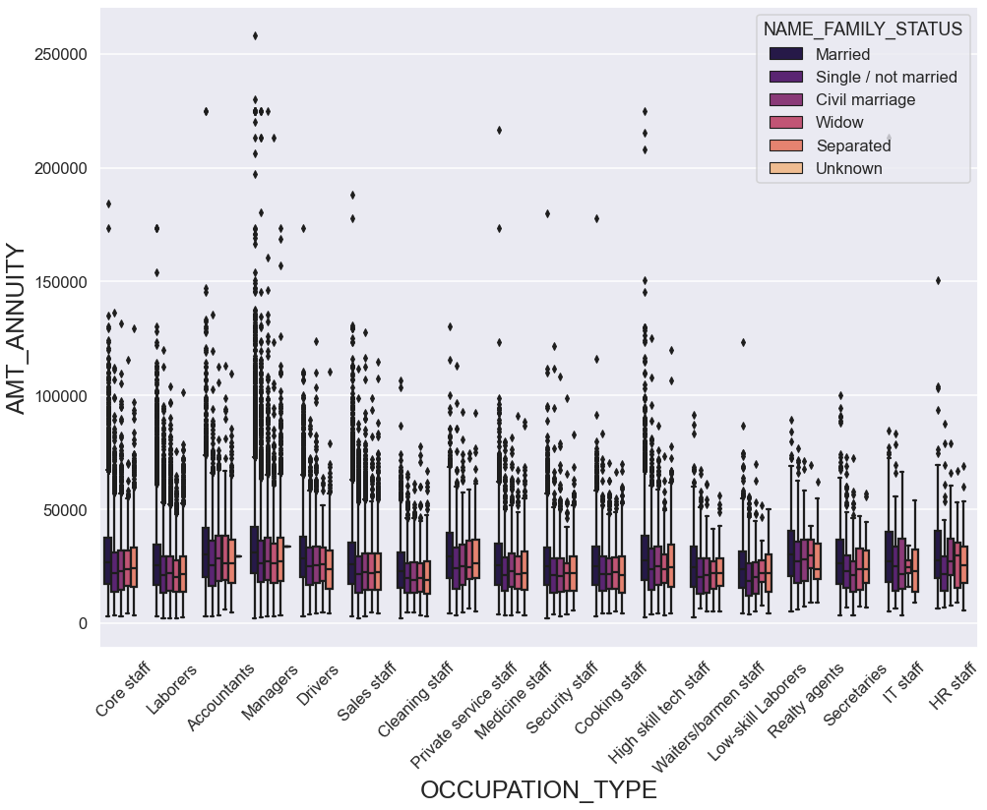
ANNUITY vs OCCUPATION TYPE
Highest Annuity
Manager with Family Status
MARRIED
50%
Accountant with family status SEPERATED
Accounts with family status MARRIED
Outliers

Slide 36
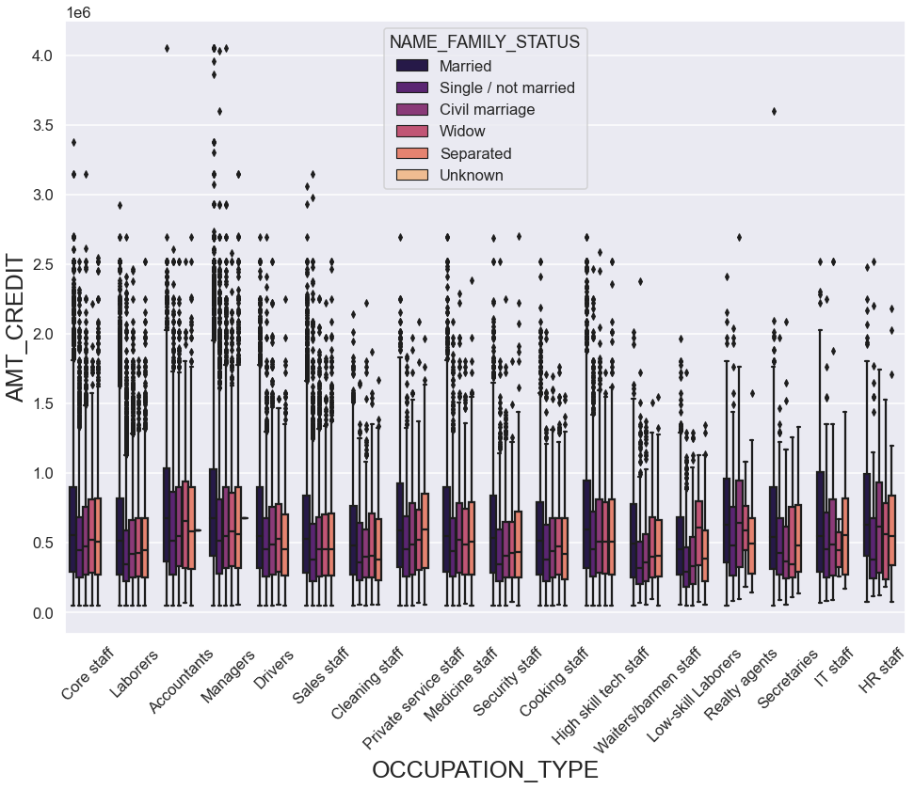
CREDIT vs OCCUPATION TYPE
Highest Credit
Accountants and Managers with Family Status
MARRIED
50%
High Skill Tech Staff with family status CIVIL MARRIAGE ,WIDOW,SEPERATED
Outliers
Accountants with family status MARRIED

Slide 37
BIVARIATE ANALY FOR TARGET 1

Slide 38
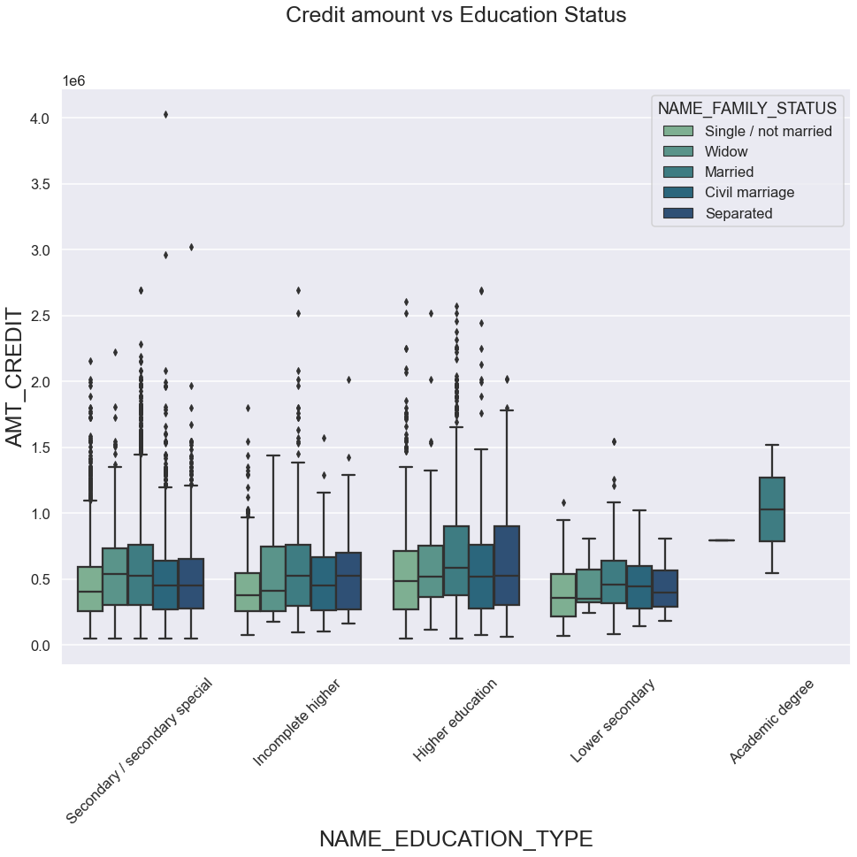
CREDIT VS EDUCATION STATUS
Highest Credit
Higher Education with Family Status
MARRIED , SEPERATED
Academic Degree with Family Status
MARRIED
50%
Secondary Special with family status CIVIL MARRIAGE
Outliers

Slide 39
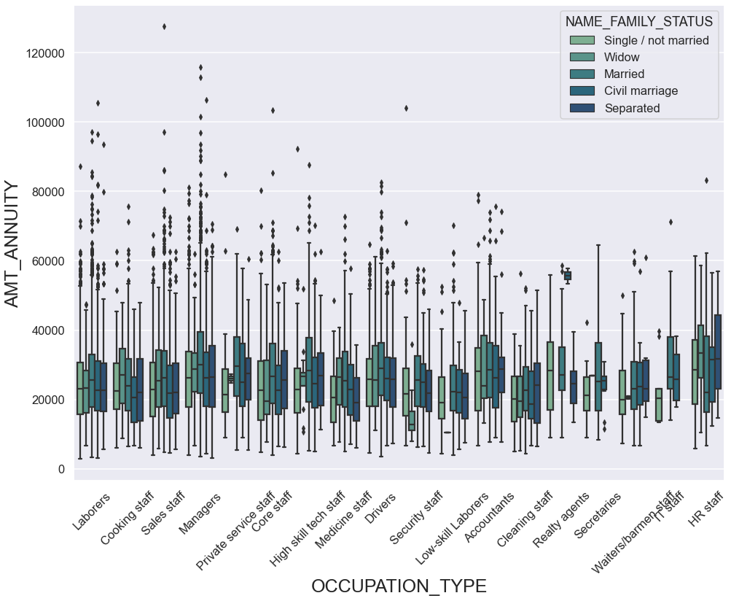
ANNUITY VS OCCUPATION TYPE
Highest Annuity
Manager with Family Status
MARRIED
50%
HR Staff with family status SEPERATED
Outliers
Sales Staff with family status MARRIED

Slide 40
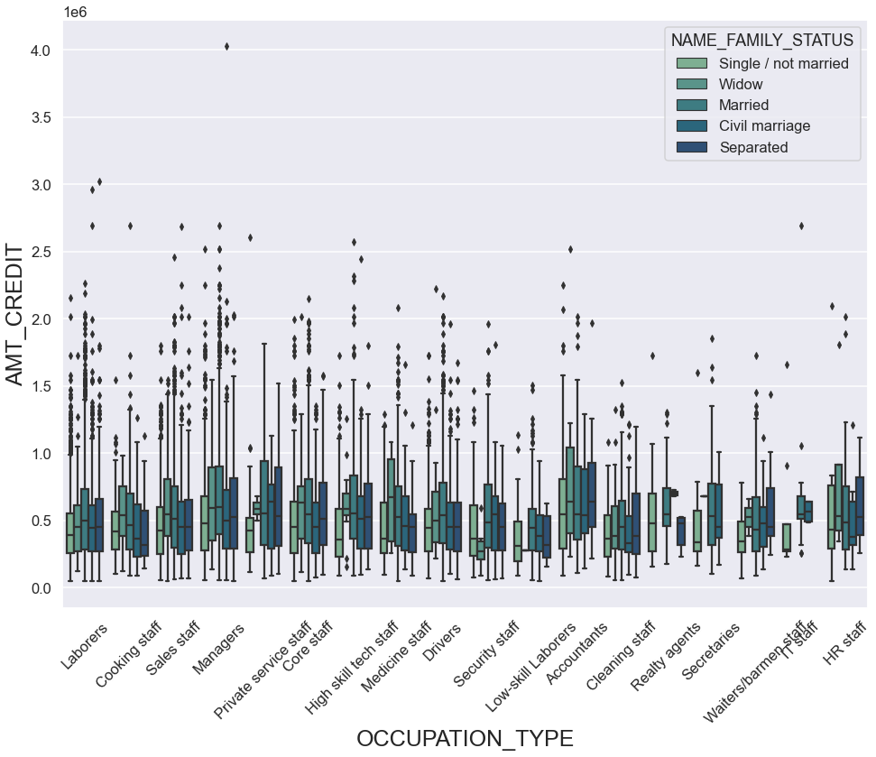
CREDIT VS OCCUPATION TYPE
Highest Credit
Private Service Staff with Family Status
MARRIED
Low Skilled Labore with Family Status
WIDOW
50%
Outliers
Manager with Family Status
MARRIED

Slide 41
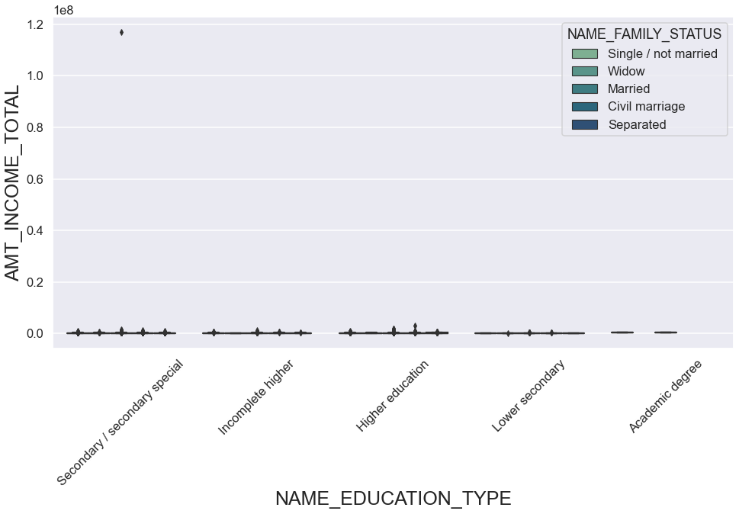
INCOME VS EDUCATION TYPE
Highest Income
Academic Degree with Family Status
MARRIED , CIVIL MARRIAGE and SEPERATED
Lower secondary & academic degree with family status SINGLE and NOT MARRIED
50%
Secondary Special with family status CIVIL MARRIED
Outliers

Slide 42
WORKING WITH PREVIOUS APPLICATION DATA

Slide 43
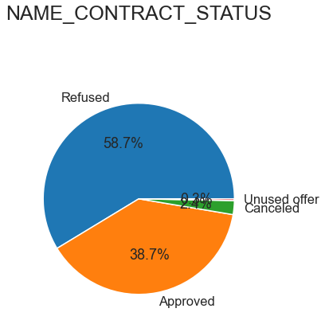
Contract type
58.7%
Loans Applications were Rejected
38.7%
Loans Applications were Approved

Slide 44
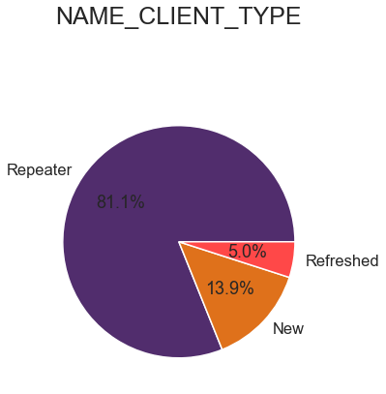
CLIENT TYPE
81.1%
Most of the Loan Applicants are REPEATERS

Slide 45
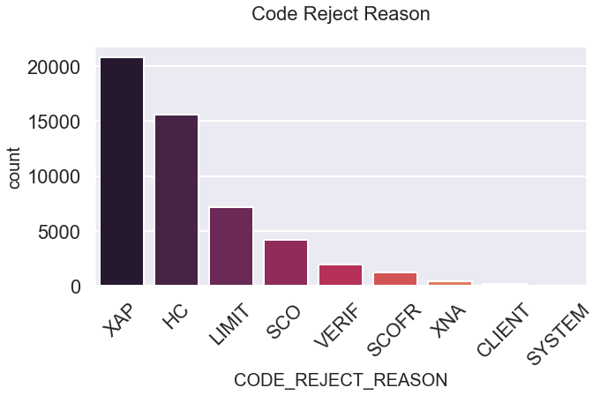
Code Reject Reason
40%
Loans Applications rejected was not applicable

Slide 46
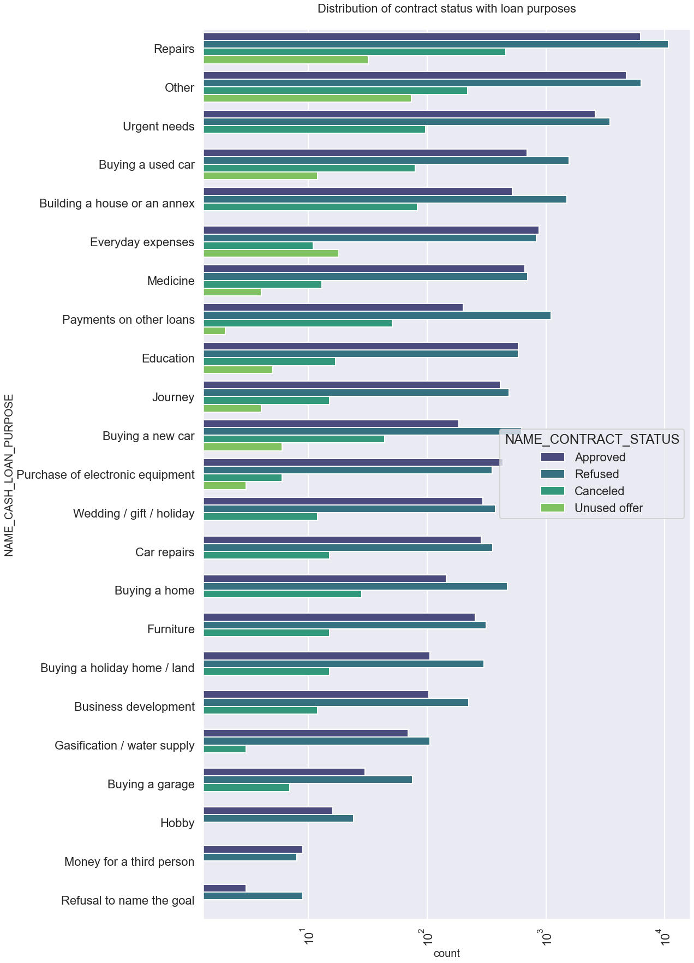
CONTRACT STATUS DISTRIBUTION
The highest loans are refused for repairs loan purpose.
Number of loan approved is more than number of loan refused for everyday expenses.
Rejected
Approved

Slide 47
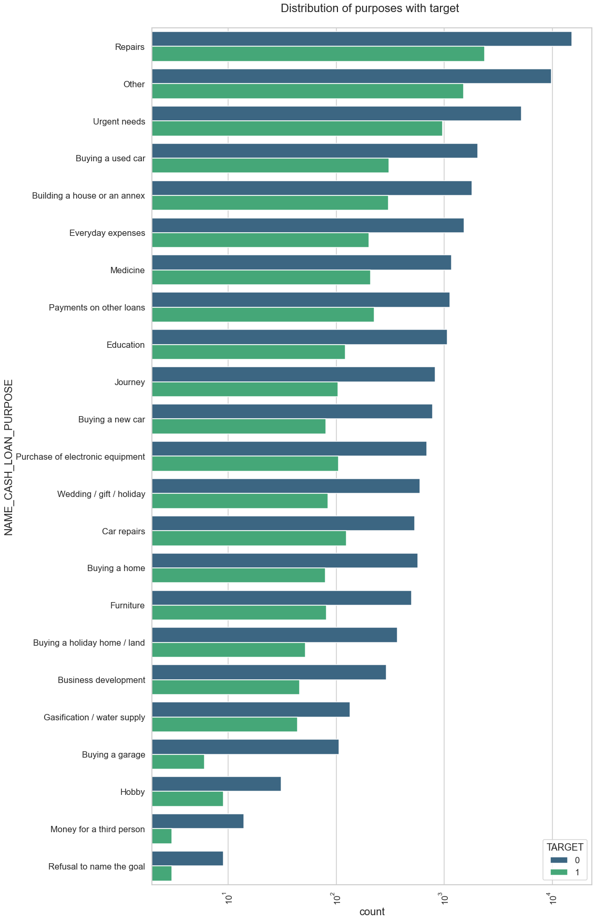
LOAN PURPOSE vs Target
The HIGHEST count of applicants who facing difficulties for loan taken for REPAIRS purpose among all loan purposes.
The LOWEST count of applicants who facing difficulties for loan taken for HOBBY, REFUSAL TO NAME and MONEY FOR 3rd PERSON
0
1

Slide 48
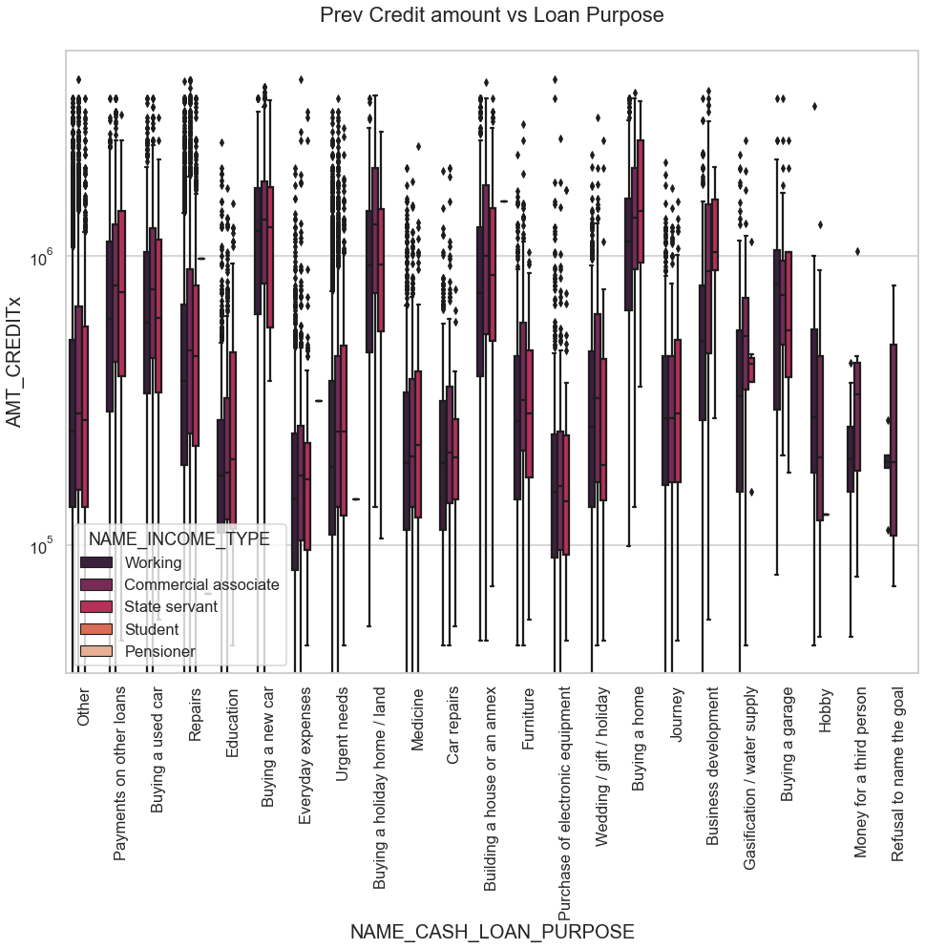
CREDIT VS LOAN PURPOSE
Highest Credit
Buying Home,Buying Land and Building Home with Income Type
COMMERCIAL ASSOCIATE
50%
Buying Home, with Income Type
STATE SERVANT
Majorities of purposes having outliers .
Others,Purchase of Electronic Equipment and Urgent Needs
Outliers

Slide 49
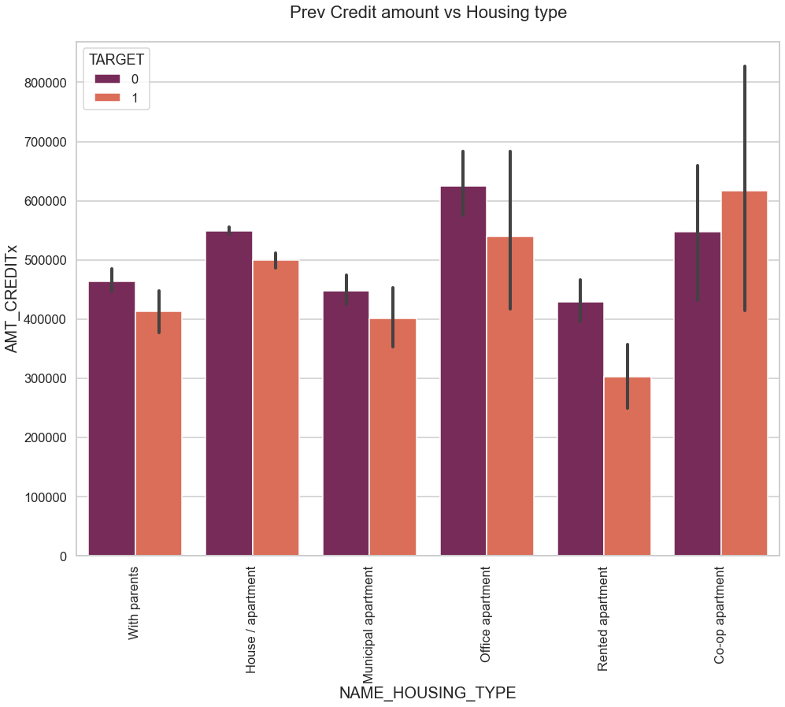
CREDIT AMOUNT VS HOUSING TYPE
The HIGHEST count of applicants who facing difficulties for loan taken for CORPORATIVE APARTMENTS
The LOWEST count of applicants who facing difficulties for loan taken for RENTED APARTMENT
0
1

Slide 50
Summary
Banks should focus more on contract type ‘Student’ ,’pensioner’ and ‘Businessman’ with housing ‘type other than ‘Co-op apartment’ for successful payments.
Banks should focus less on income type ‘Working’ as they are having most number of unsuccessful payments.
Also with loan purpose ‘Repair’ is having higher number of unsuccessful payments on time.
Get as much as clients from housing type ‘With parents’ as they are having least number of unsuccessful payments.

Slide 51
Thank you

